Slide 2
Umbraco is the biggest .NET open-source CMS in the world
+750.000
Powering the biggest organizations in the world
live websites across the world
Council of the european union
The Umbraco CMS was awarded first place in the “Content Management System” category for The Visual Studio Magazine 2020 Reader’s Choice Award.
Handpicked out of 35,000 companies across Europe, we were among the 3 final winners of the Future Unicorn Award 2019 by DIGITALEUROPE.

Slide 3
Umbraco is the biggest .NET open-source CMS in the world
+750.000
Powering the biggest organizations in the world
live websites across the world
Council of the european union
The Umbraco CMS was awarded first place in the “Content Management System” category for The Visual Studio Magazine 2020 Reader’s Choice Award.
Handpicked out of 35,000 companies across Europe, we were among the 3 final winners of the Future Unicorn Award 2019 by DIGITALEUROPE.

Slide 4
Facts
Biggest and fast growing Microsoft .Net based CMS (open source)
+750,000 active websites worldwide
More than a decade of history (2005)
100+ people working at Umbraco HQ
More than 1,500 partners worldwide
300+ add-ons from community
+220,000 active Umbraco community members
Offices in DK, NL & US

Slide 5
Europe and US offices
Strong Umbraco HQ
Sales - Support - Development
Account management
Sales Support
Support and Advising
Global activities
Regional Partner activities
0.4
0.3
0.3
Growing US Office
Sales - Support
Account management
Sales Support
Support
Regional Partner activities
UK
Denmark
Sweden
Netherlands
US
Sales staff (NL)
Sales
Account management
Regional Partner activities
Umbraco focus markets
Umbraco live websites

Slide 6
The Flexible
CMS
Umbraco gives you the freedom to manage and do things your way
Notes:
The Flexible CMS
Every project has different needs
Kept Umbraco neat and open to get freedom to create
No limitations – lots of flexibility

Slide 7
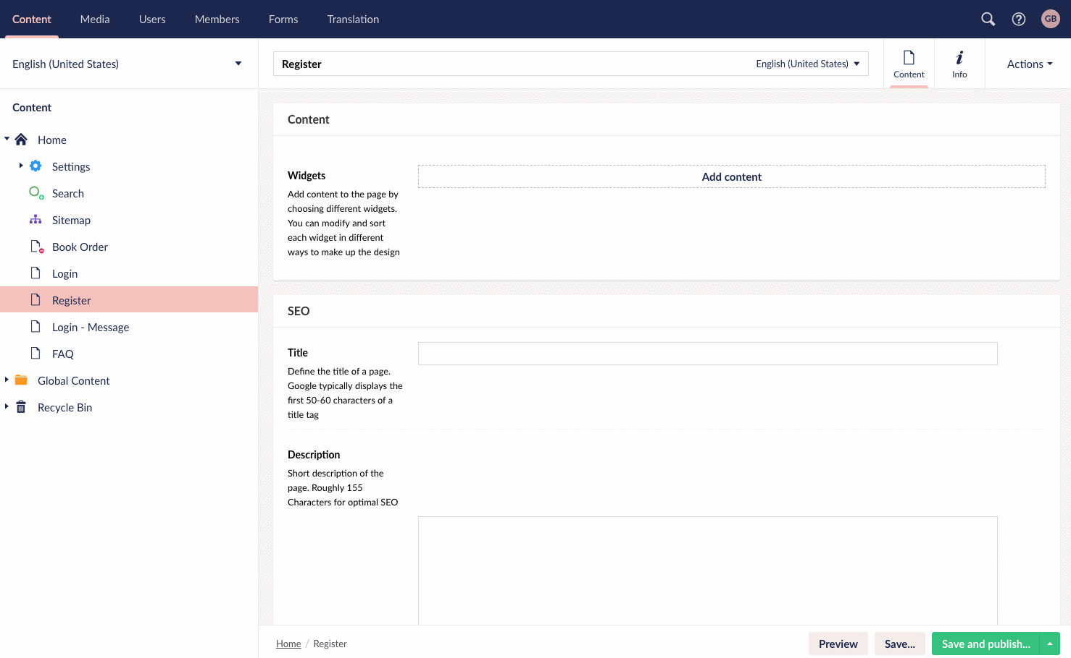
The Friendliest,
Editor-Centered
User interface
At Umbraco, we build software
that brings a smile on peoples faces.

Slide 8
Best of Breed Approach
...
Personalization
Marketing autom.
Focus on core functionality
Customer chooses integrations based on individual requirements and demands
Com merce
Umbraco CMS

Slide 9
The benefits of Best of Breed
Access to highly specialized products and services
Cloud and SaaS delivery models are facilitating a new-wave of opportunities for faster implementation of best of breed software
Greater commercial leverage and reduced risk
Integration-platform-as-a-service vendors offer an accelerated and reduced-risk path to adopting robust and secure integration capability
Umbraco is a Best of Breed CMS player
Umbraco is the only open-source best of breed CMS for DXP solutions in the Microsoft space
Customizable CMS platform for DXP
Umbraco is built as a customizable CMS platform upon which additional functionalities and integrations can be added enabling a complete customized DXP solution
Best of breed CMS that supports pick and mix your prefered mar tech tools. This is increasingly preferred over integrated suite solutions
Enterprises with strong preference for integrated Suite⁽¹⁾
24%
8%
2018
2019
Source: 1) Gartner 2019 Marketing Technology Survey

Slide 10
The Friendliest
CMS Community
On The Planet
At the heart of Umbraco is our vibrant community of over 220.000 contributing developers and crafts people
Notes:
A strong Ecosystem
Backed by a professional and highly skilled commercial company
Open Source Community of over 220.000 active members
Over 1.500 dedicated partners around the world

Slide 11
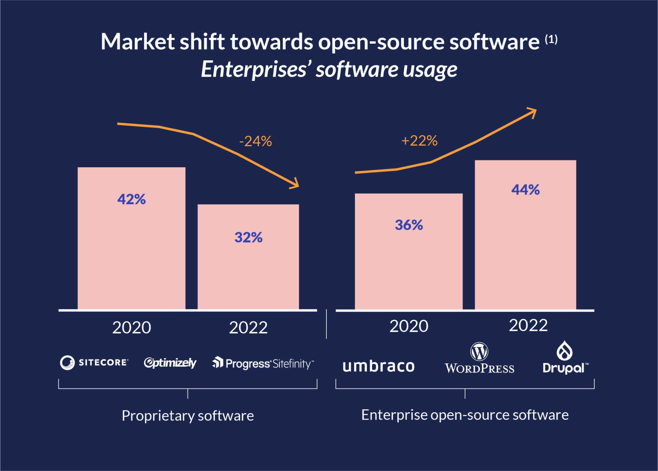
Increasing demand for faster innovation
The community of developers makes open-source software more agile and enables faster innovation
The demand for fast innovation is driven by shorter production cycles as customers demand more frequent content and increasing omnichannel integration
Demand for reduced vendor dependencies
Open-source standards around communication protocols and data formats improve interoperability
Open source reduces dependencies and mitigates the risk of vendor lock-in
Today, open-source is mature
Source: 1) RedHat survey

Slide 12
Get Specialist Answers From Support Warriors
Get help and guidance from seasoned experts, download and collaborate on plugins and extensions
Notes:
With a support plan you get a direct helpline to the specialist support team at Umbraco HQ

Slide 13
Umbraco Tech Stack
cloud
heartcore
Open-source CMS
Classic CMS with maximum flexibility for developers
All-in-one
managed hosting
Headless CMS
Content management as a service with omnichannel support through APIs and libraries

Slide 14
Tech vision
heartcore
Umbraco Tech Stack
Focus on digital experience
Broaden Umbraco reach by embracing the need for full digital experience and include broader tooling to support it.
cloud
heartcore
The SaaS ecosystem
Expand the ecosystem related to Umbraco Cloud products with better options to integrate and a better support system for technology partners and package developers.
Classic CMS with maximum flexibility for developers
All-in-one
managed hosting
Headless CMS
Content management as a service with omnichannel support through APIs and libraries
Simplify Umbraco Cloud offering
Reduce the number of products by finding synergies between them and thereby simplify the total offerings while making the joined product more powerful.
Open-source CMS
‘The core of Umbraco’
Improve agency tooling
Improve SaaS products for easier overview, tooling and
engagement for heavy use by partners and cloud powerhouses.
This includes making it easy to do business - low friction delivery.
Software-as-a-Service (SaaS)

Slide 15
Umbraco Cloud
Developers time keeps becoming more and more valuable, so it's crucial that time is spent on what makes a difference and not tedious tasks that add no or little value to customers.
That's our goal with Umbraco Cloud. Combine the flexibility you already know and love of the Umbraco CMS with a platform that takes care of installing, upgrading, team management and deployments, leaving more time in projects to spend on features for your customers.
Niels Hartvig, Founder of Umbraco

Slide 16
Umbraco Cloud
All-in-one hosting on Microsoft Azure
Automated updates – Stay secure and up to date
Baseline feature – spin up a new project in a few minutes or use Baseline to re-use project components from a master
Easy to deploy content and features using Deploy™
Automated TLS certificates
Easier user management
Scalable solution - Flexibility and predictability in projects
Included Umbraco Support

Slide 17
Umbraco Heartcore
A headless CMS - Friendly at its core

Slide 18
Omnichannel Content Management and Delivery
Heartcore is built for Omnichannel. Because of its RESTful API you are able to manage and deliver content to all your customers on any device - whatever that frontend might be.
Umbraco CMS is .NET, but with our headless CMS there's no need for you to be a .NET or Umbraco Developer. You can take advantage of the intuitive content management features and use the coding language you're skilled in to make things happen!

Slide 19
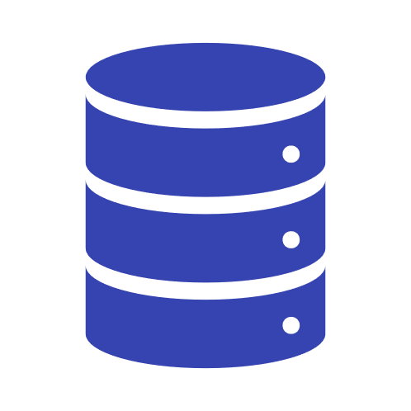
Umbraco Heartcore Features
Managed Hosting
Scalable hosting with one-click project set-up, powered by Microsoft Azure.
Content Delivery Network (CDN)
Fast delivery of content to any frontend and users, wherever in the world they might be, using the CDN capabilities of Cloudflare.
Managed APIs
We will keep your APIs up-to-date and make sure that all of your content, media etc. are automatically exposed via a RESTful API.
Managed Backend
We will keep the Backend of your Heartcore projects up-to-date with the latest features and security fixes, so you don’t need to worry about maintaining an extra codebase.
Webhooks
Hookup and use all the best-of-breed tools you love, without compromising on your workflows. You're also able to trigger a URL on Save, Delete and Publish events.
Also included...
Platform Support
Unlimited Team members
GDPR ready

Slide 20
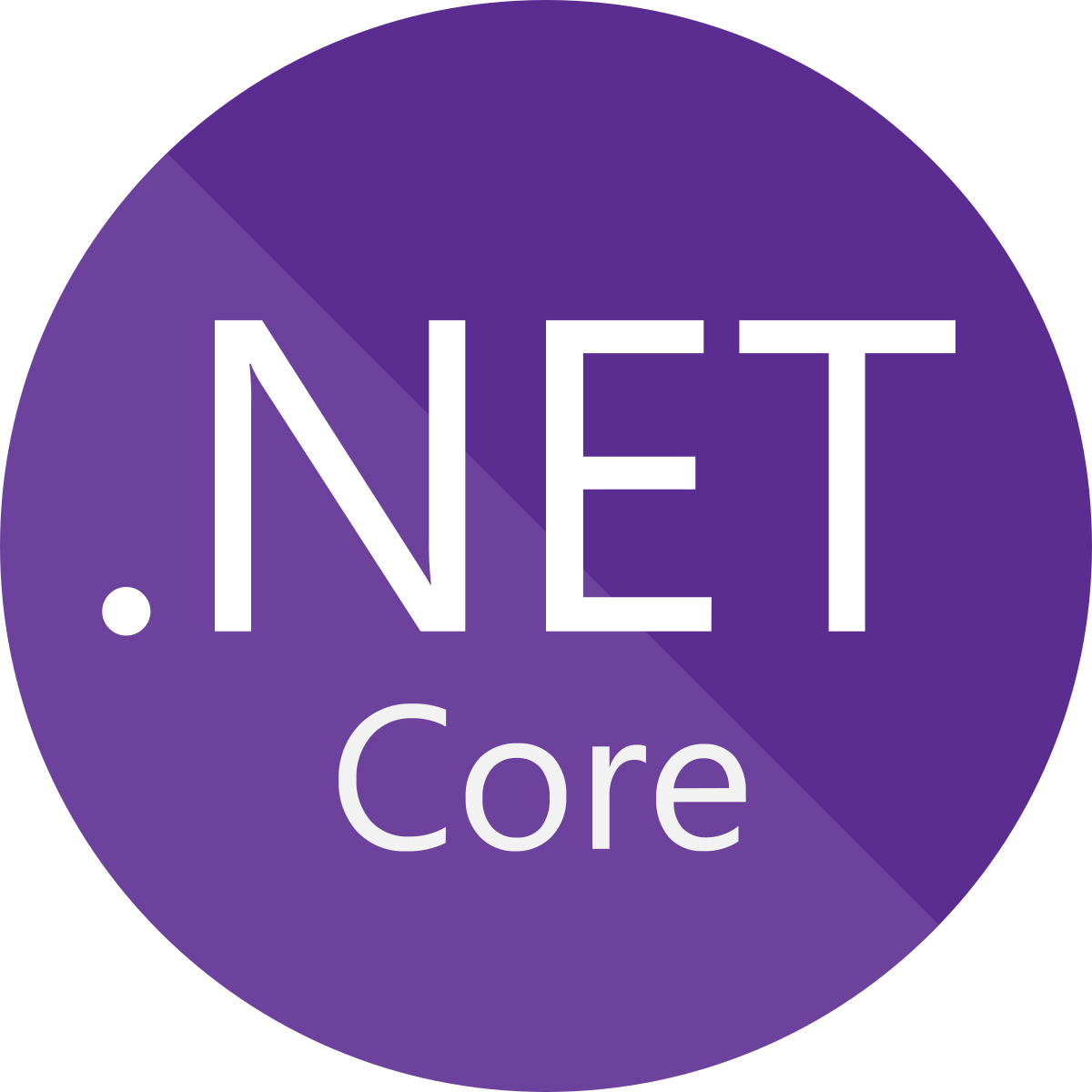
Market Trends
Content is no
longer enough
Privacy
Omnichannel everywhere
Desire for ASP.NET core*
Open Source is matured and accepted
No/low code
* https://insights.stackoverflow.com/survey/2020#technology-most-loved-dreaded-and-wanted-web-frameworks

Slide 21
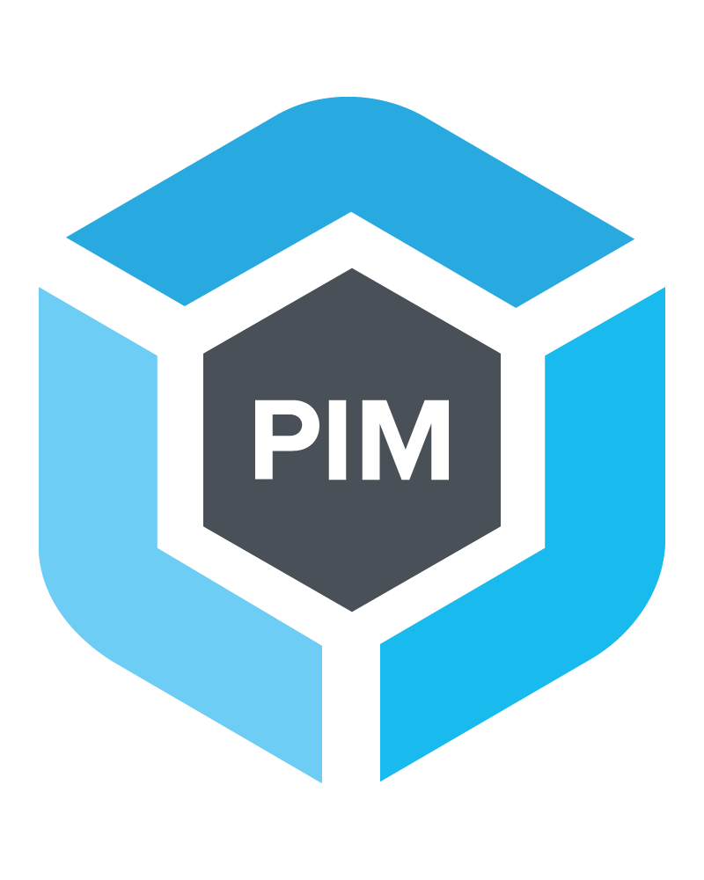
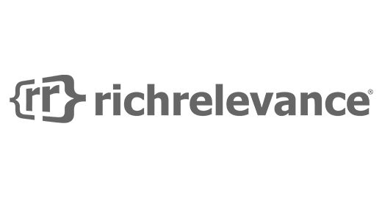
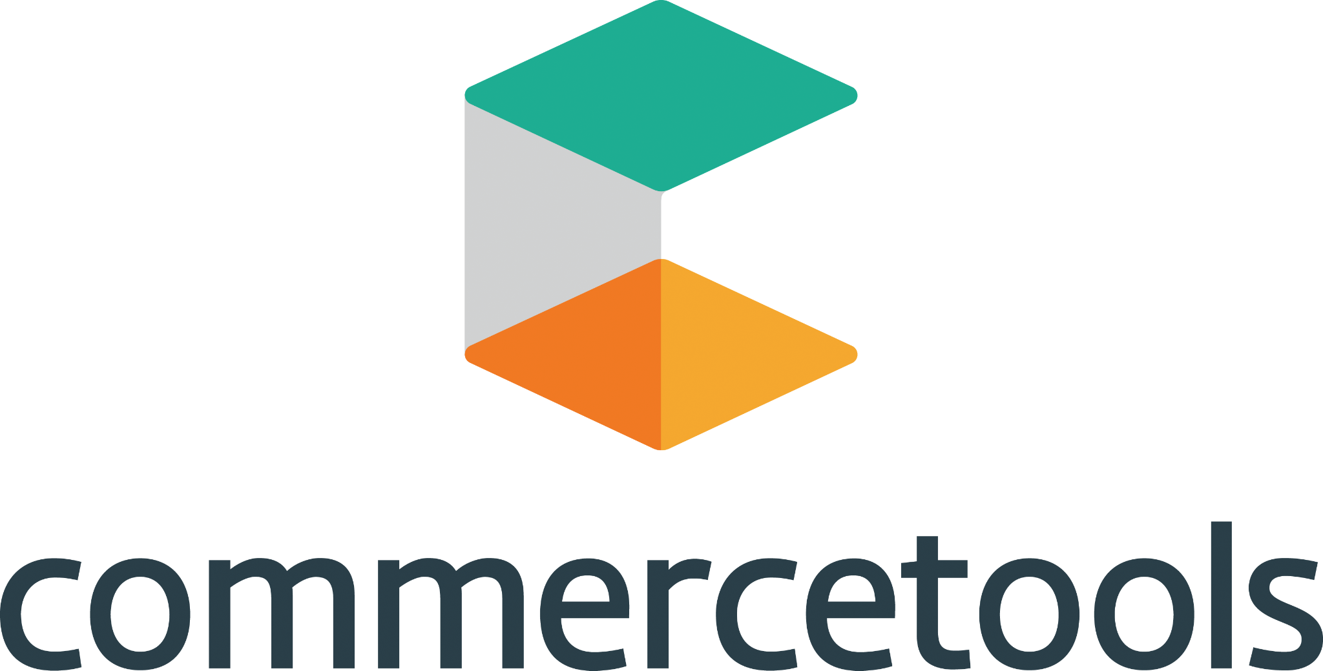
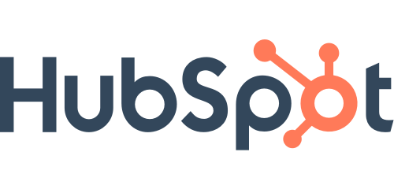
Umbraco Marketplace
E-commerce
PIM/DAM
Recommendation & personalisation
Campaign Management
Analysis & Insights
CMS Extensions
Umbraco CMS
Notes:
Umbraco is a CMS and has always supported the Best-of-Breed strategy. “You can build everything with Umbraco” - That’s usually what developers, agencies and Umbraco HQ’ers says about Umbraco… But it can be hard for people not knowing Umbraco to “imagine“
A Digital Experience Platform (DXP) is an emerging category of enterprise software seeking to meet the needs of companies undergoing digital transformation, with the ultimate goal of providing better customer experiences. DXPs can be a single product, but are often a suite of products that work together.
Umbraco is conceptualizeíng the Umbraco Best-of-Breed - DXP to help new people, customers, developers and agencies, to understand how to build great integrated projects.

Slide 22
An Award winning CMS
Umbraco has won many awards including:
The Visual Studio Magazine 2020 Reader’s Choice Award: Gold, Content Management System
DIGITALEUROPE: Future Unicorn Award
CMS Critics’ Awards: Best Enterprise CMS

Slide 23
Umbraco Marketplace
E-commerce
PIM/DAM
Recommendation & personalisation
Campaign Management
Analysis & Insights
CMS Extensions
Umbraco CMS
Notes:
Umbraco is a CMS and has always supported the Best-of-Breed strategy. “You can build everything with Umbraco” - That’s usually what developers, agencies and Umbraco HQ’ers says about Umbraco… But it can be hard for people not knowing Umbraco to “imagine“
A Digital Experience Platform (DXP) is an emerging category of enterprise software seeking to meet the needs of companies undergoing digital transformation, with the ultimate goal of providing better customer experiences. DXPs can be a single product, but are often a suite of products that work together.
Umbraco is conceptualizeíng the Umbraco Composable DXP to help new people, customers, developers and agencies, to understand how to build great integrated projects.

Slide 24
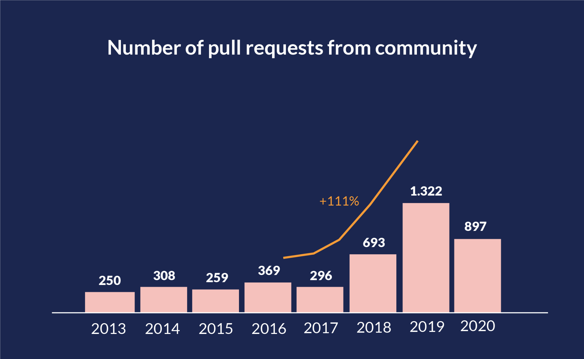
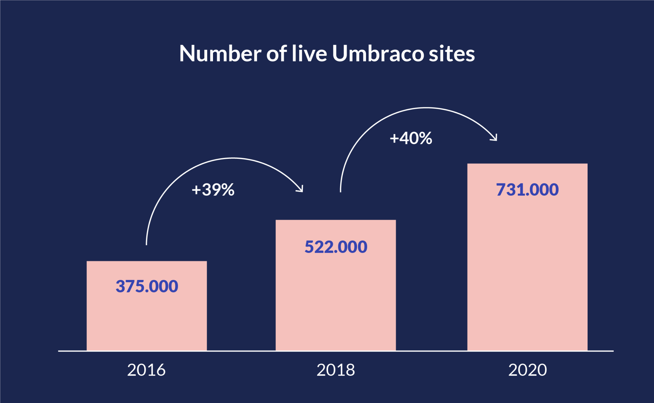
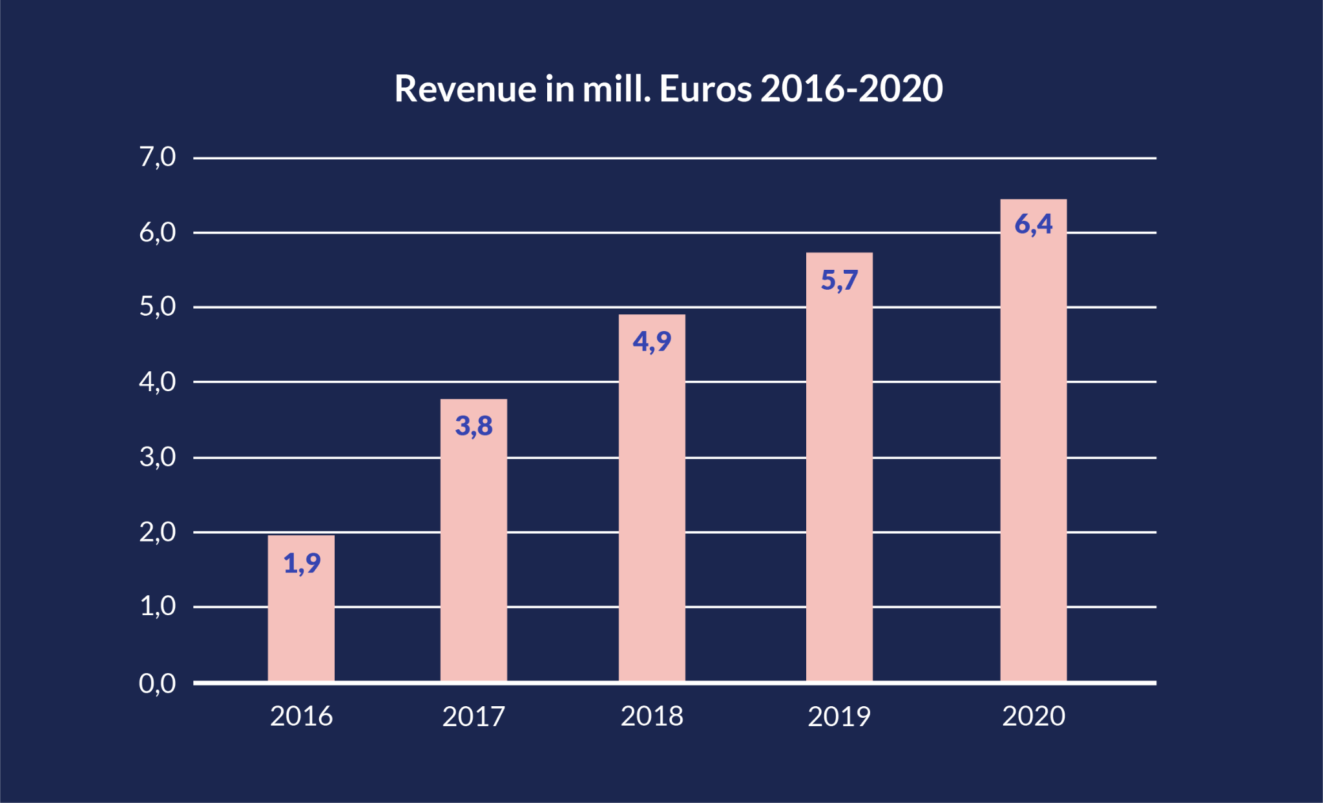
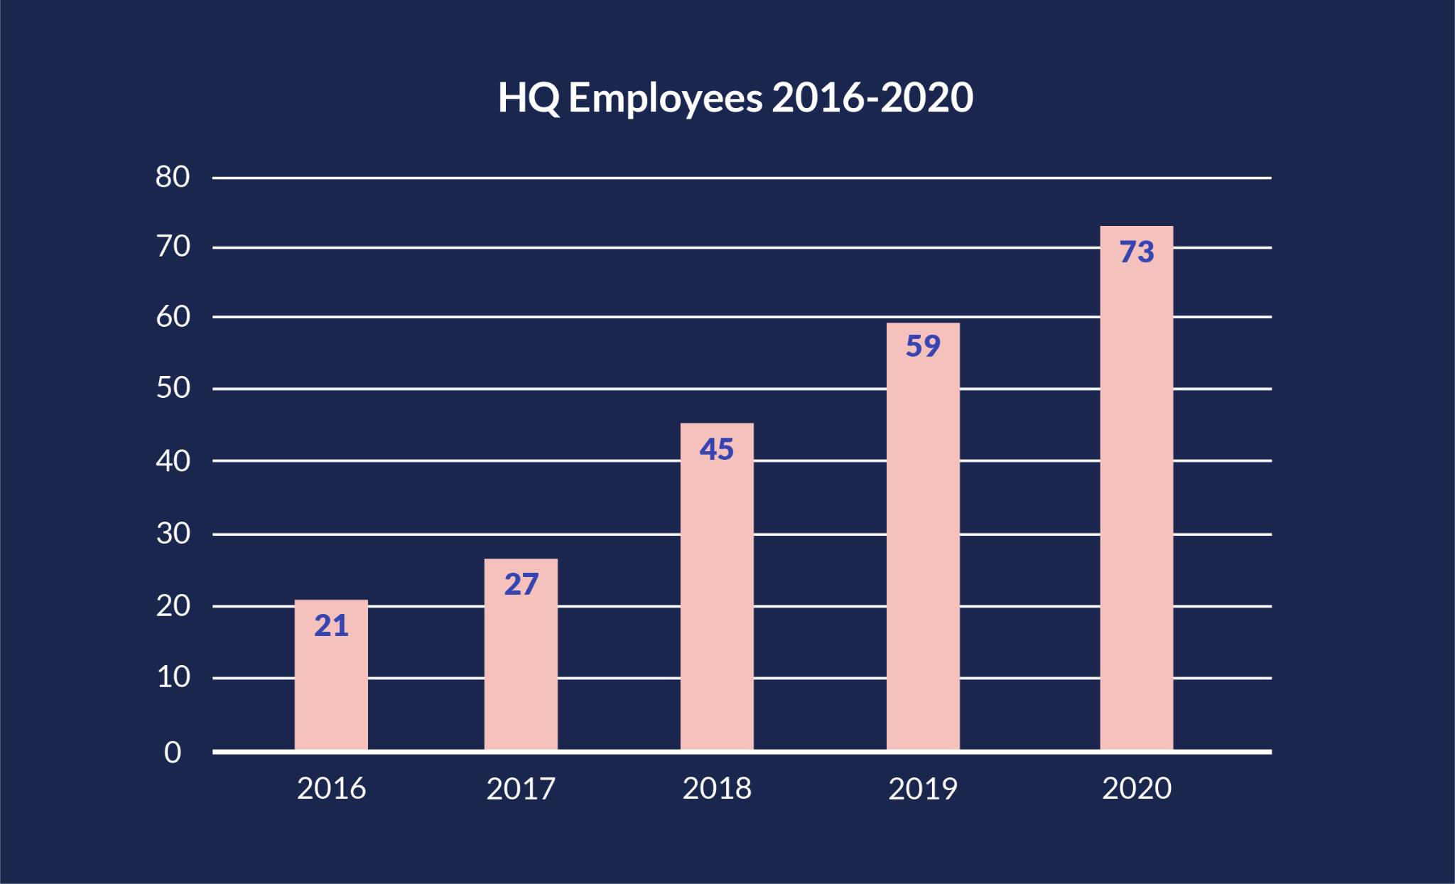
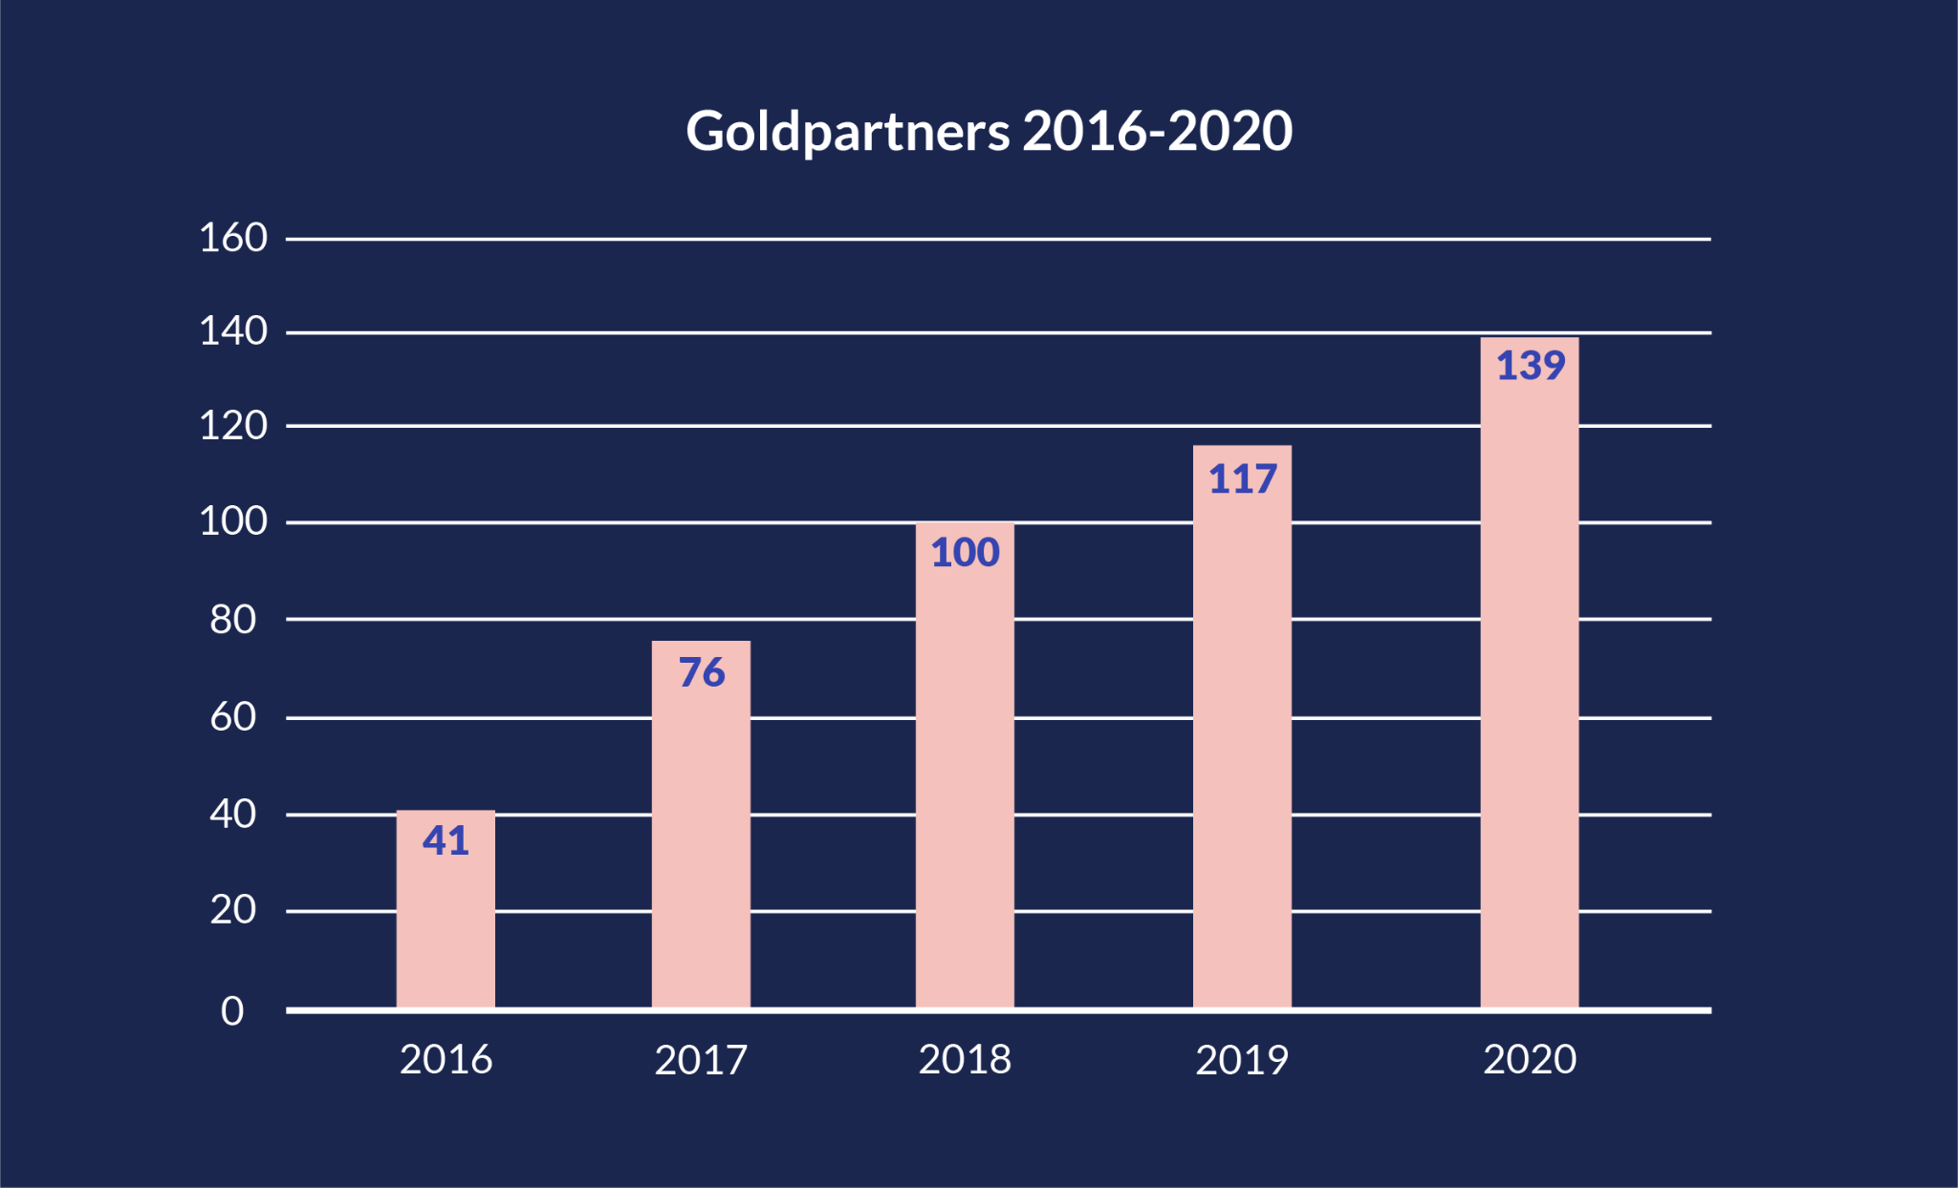
Umbraco stronger than ever
Notes:
The sheer number of installs running on Umbraco

Slide 25
Umbraco timeline
Cloud offering launched
Umbraco Cloud is CMS as a service with automated patching and upgrades in a multi environment setup
Open source CMS
Umbraco 2.0 launched as open source CMS and first Umbraco developer conference, Code Garden, conducted
Headless
CMS launched
Umbraco HeartCore is content management as a service with omnichannel support through APIs and libraries
Our Umbraco community site launched
A platform for strengthening and growing the online developer community.
New ownership
Majority share acquired by Monterro Growth Investor
2003
2007
2013
2016
First edition
Umbraco 1.0 was launched by Niels Hartvig
2005
2009
2015
2018
2021
Umbraco HQ founded
Social coding at Github
The Umbraco Source Code
becomes available on GitHub making it much more open-source- friendly
New
management
team
Niels goes fulltime and hire the first employee to develop Umbraco further. Most valued people nomination is launched to strengthen community

Slide 26
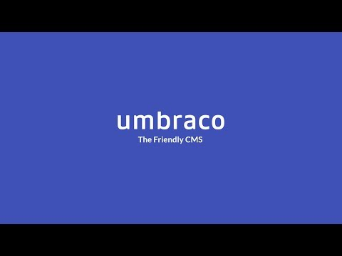

Slide 27
News and what to come
News
https://umbraco.com/blog/
Product roadmap
https://umbraco.com/products/roadmap/
Training courses
https://umbraco.com/training/course-details/
Community events
https://community.umbraco.com/events/

Slide 28
Thank You

